Slide 1
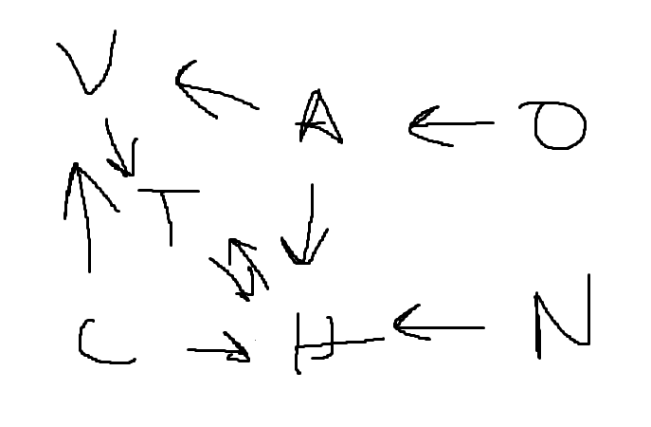
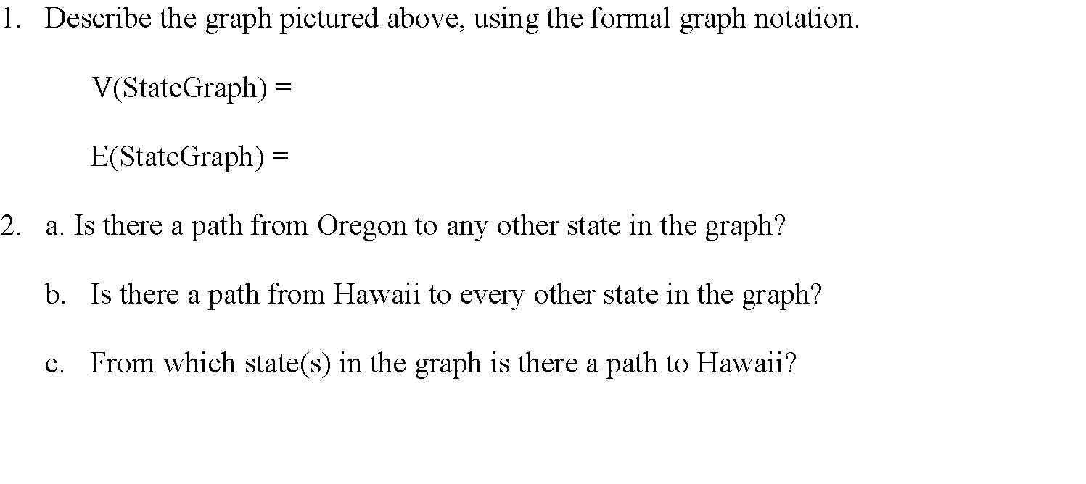
CMSC204
Kartchner
V(StateGraph) = {Oregon, Alaska, Texas, Hawaii, Vermont, NewYork, California}
E(StateGraph) = {(Alaska, Oregon), (Hawaii, Alaska), (Hawaii, Texas), (Texas, Hawaii),
(Hawaii, California), (Hawaii, New York), (Texas, Vermont), (Vermont, California), (Vermont, Alaska)}
1. Draw the StateGraph
Alaska, California, Hawaii, New York, Oregon, Texas, Vermont
{(Alaska, Oregon), (Hawaii, Alaska), (Hawaii, Texas), (Hawaii, California), (Hawaii, New York), (Texas, Hawaii), (Vermont, California), (Vermont, Alaska)}
No
No
New York, California, Alaska

Slide 2
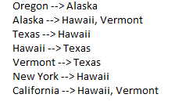
a. Show the adjacency matrix that would describe the edges in the graph. Store the vertices in alphabetical order
States
Alaska
California
Hawaii
New York
Oregon
Texas
Vermont
0 | - | 1 | - | - | - | 1
- | 0 | 1 | - | - | - | 1
- | - | 0 | - | - | 1 | -
- | - | 1 | 0 | - | - | -
1 | - | - | - | 0 | - | -
- | - | 1 | - | - | 0 | -
- | - | - | - | - | 1 | 0
3. b. Show the adjacency lists
that would describe the edges in the graph

Slide 3
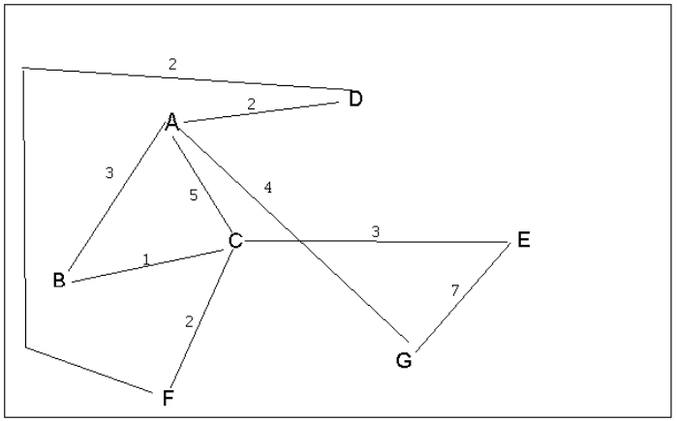
4 a. Which of the following lists the graph nodes in depth first order beginning with E?
A) E, G, F, C, D, B, A
B) G, A, E, C, B, F, D
C) E, G, A, D, F, C, B
D) E, C, F, B, A, D, G
4 b. Which of the following lists the graph nodes in breadth first order beginning at F?
A) F, C, D, A, B, E, G
B) F, D, C, A, B, C, G
C) F, C, D, B, G, A, E
D) a, b, and c are all breadth first traversals

Slide 4
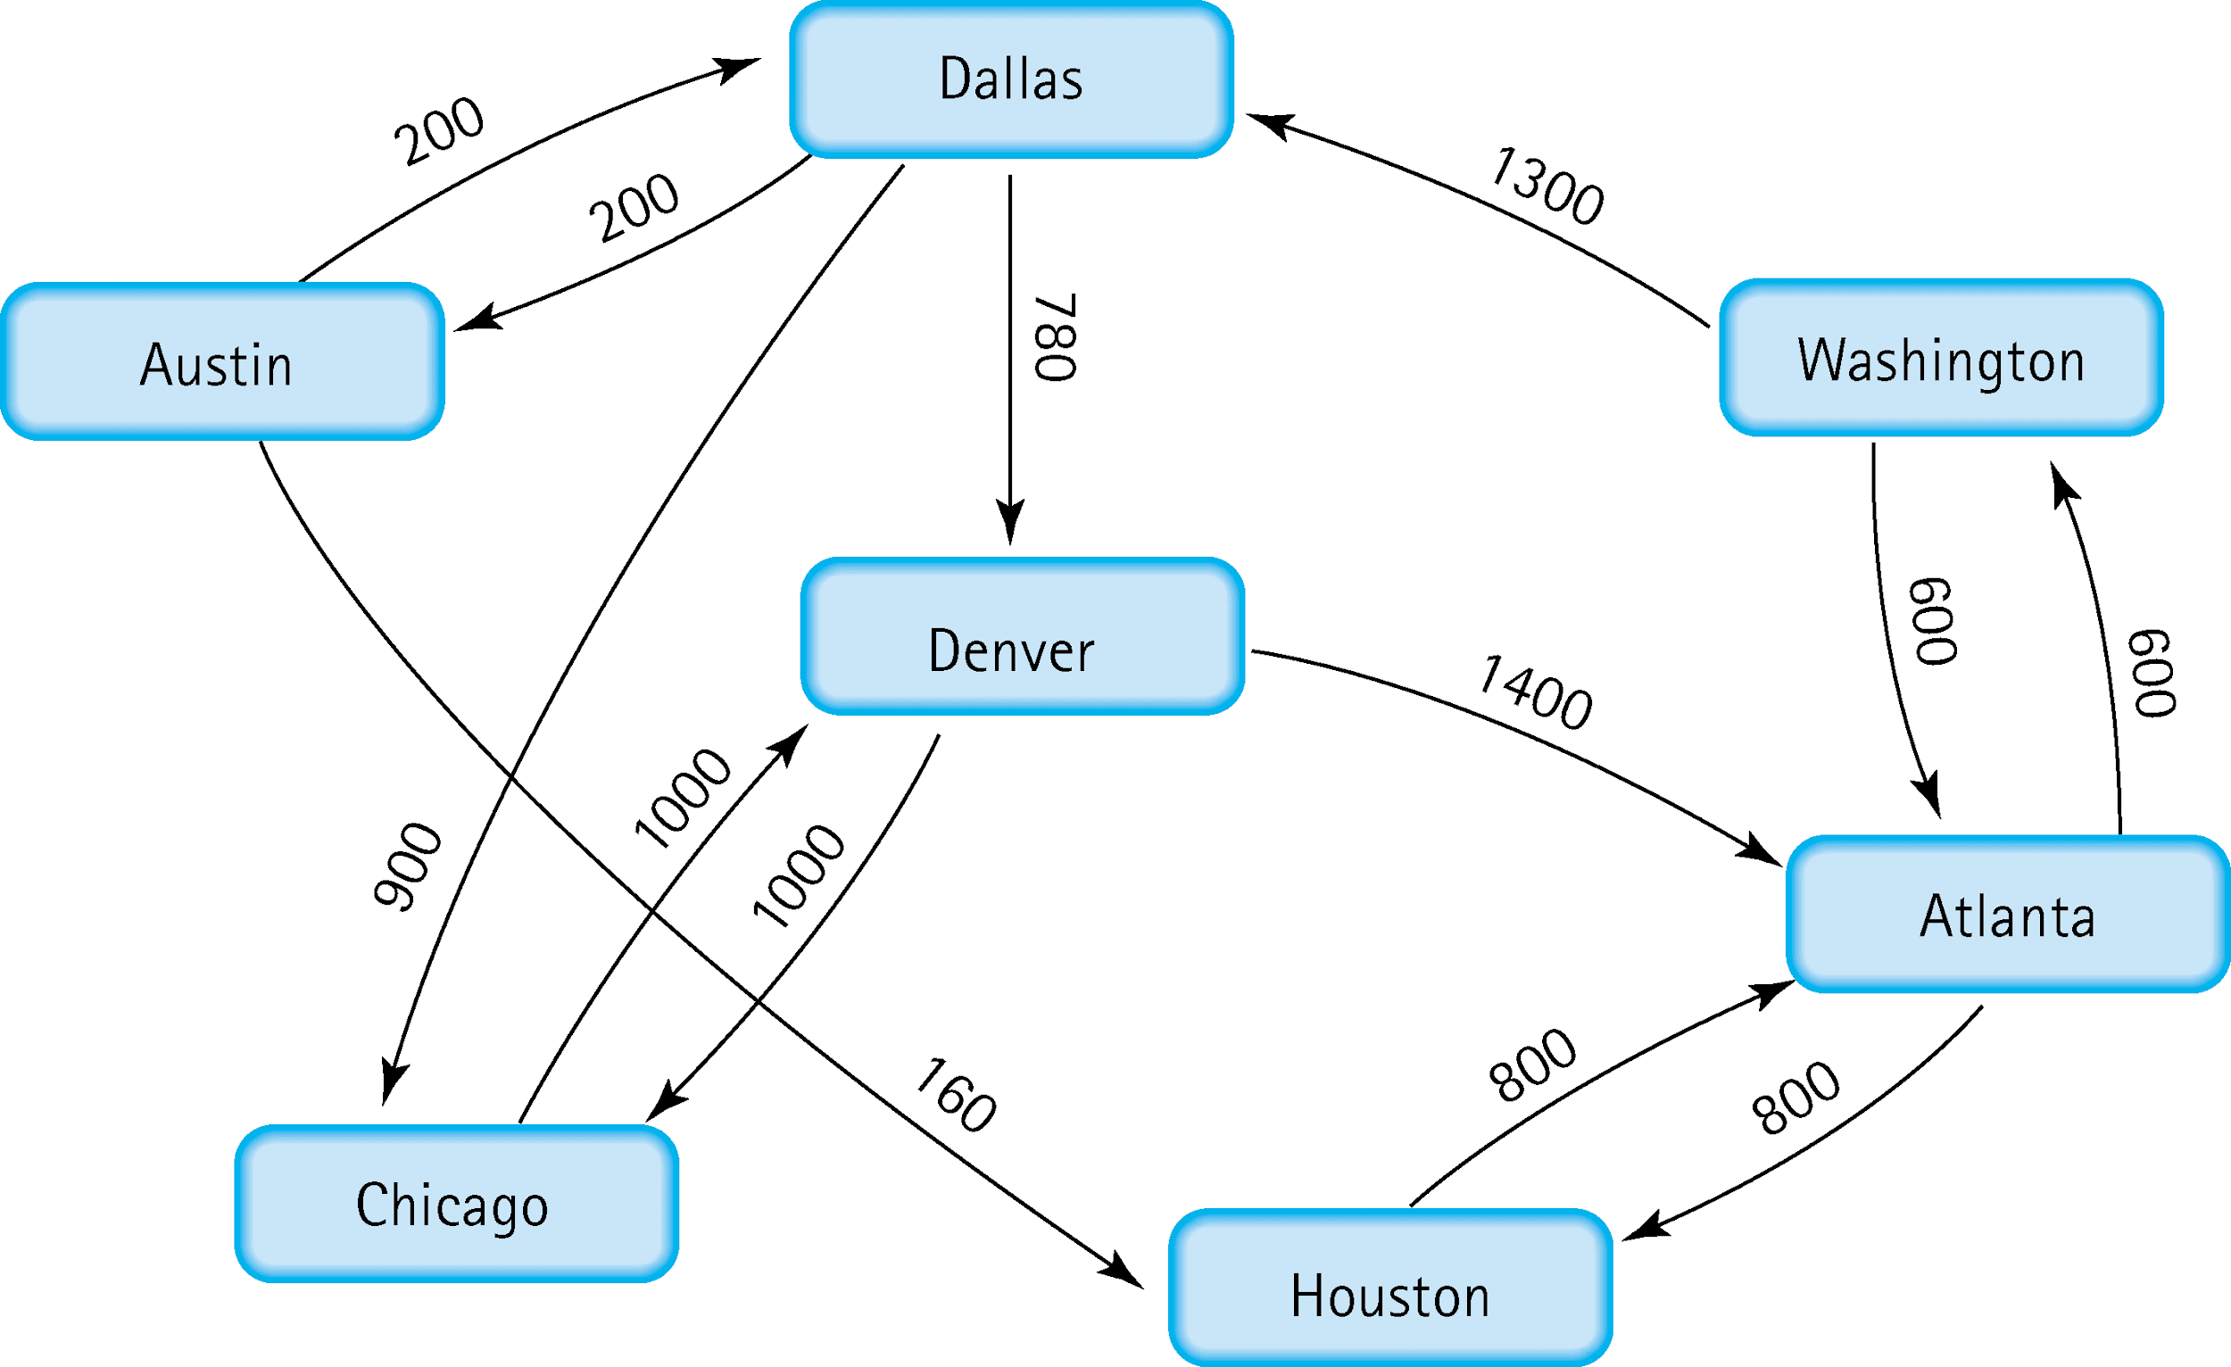
5. Find the shortest distance from Atlanta to every other city
Atlanta 0
Washington 600 Atlanta
Houston 800 Atlanta
Dallas 1900 Washington
Denver 2680 Dallas
Chicago 2800 Dallas
Austin 2100 Dallas

Slide 5
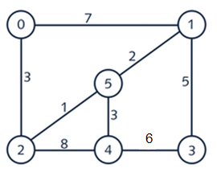
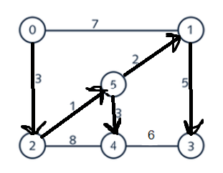
6. Find the minimal spanning tree using Prim’s algorithm. Use
0 as the source vertex . Show the steps.
0 to 2
2 to 5
5 to 1
1 to 3
5 to 4

Slide 6
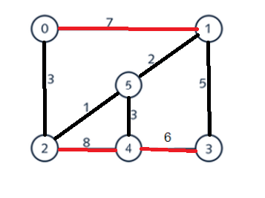
7. Find the minimal spanning tree using Kruskal’s algorithm.
Show the weights in order and the steps.
2 to 5
5 to 1
2 to 0
5 to 4
1 to 3

Slide 7
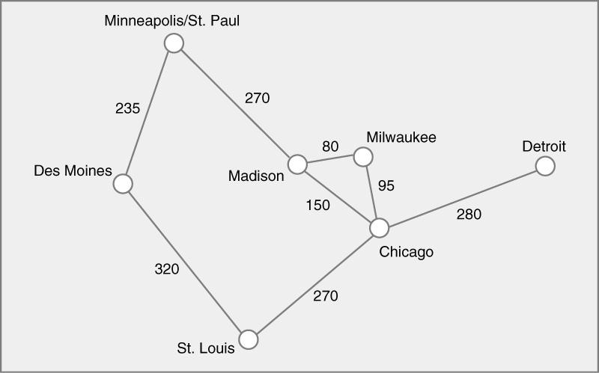
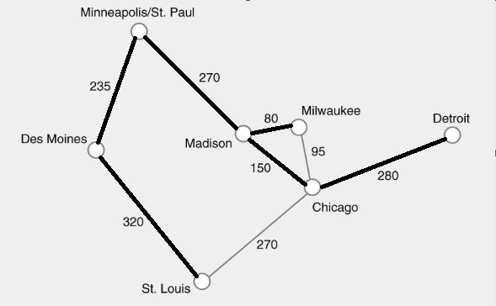
8. Find the minimal spanning tree using the algorithm you prefer. Use
Minneapolis/St. Paul as the source vertex
Minneapolis/St. Paul - -
Des Moines 235 Minneapolis/St. Paul
Madison 270 Minneapolis/St. Paul
Milwaukee 350 Madison
St. Louis 555 Des Moines
Chicago 420 Madison
Detroit 700 Chicago

Slide 8
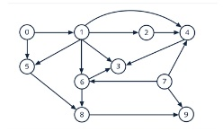
9. List the nodes of the graph in a breadth first topological ordering. Show the
steps using arrays predCount, topologicalOrder and a queue
0, 1, 2, 5, 7, 4, 3, 6, 8, 9

Slide 9

10. List the nodes of the graph in a breadth first topological ordering.
Start, Discrete Math, Programming 1, Computer Organization, Programming 2, Algorithms, High-Level Languages, Operating Systems, Theory of Computation, Compilers, Senior Seminar, End

